Slide 1

Cluster Analysis of London Real Estate Market

Slide 2
Introduction
London Real Estate Market is doing poorly due to:
Brexit
Hidden price falls
Record-low sales
Depreciation
Tax hikes

Slide 3
Business Problem
Provide advice and support to homebuyers purchasing a suitable real estate in London in this uncertain economic crisis

Slide 4
Solution
Cluster the neighbourhood of London for recommendation of venues and current average price of housing so that homebuyers can make a strategic and sound decision to invest

Slide 5
Data and Methodology
Data
Merge data on London properties and relative price paid data from HM Land Registry and data on amenities and essential facilities using Foursqaure API
Methodology
Collect evaluation data
Explore and understand
Data preparation and pre-processing
Modeling

Slide 6
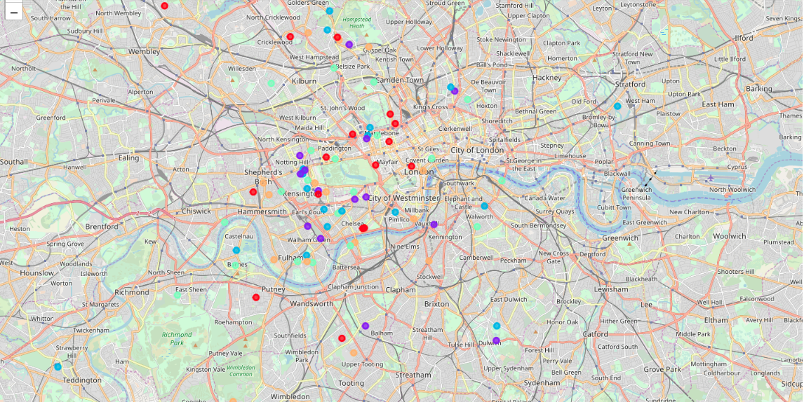
Approach – K Means Clustering

Slide 7
Conclusion
West London (Notting Hill, Kensington, Chelsea, Marylebone) and North-West London (Hampsted) might be considered highly profitable venues to purchase a real estate
South-West London (Wandsworth, Balham) and North-West London (Isliington) are arising as next future elite venues with a wide range of amenities and facilities
Clusters 0, 2 and 4 may target home buyers prone to live in 'green' areas with parks, waterfronts
Clusters 1 and 3 may target individuals who love pubs, theatres and soccer.

